Slide 1
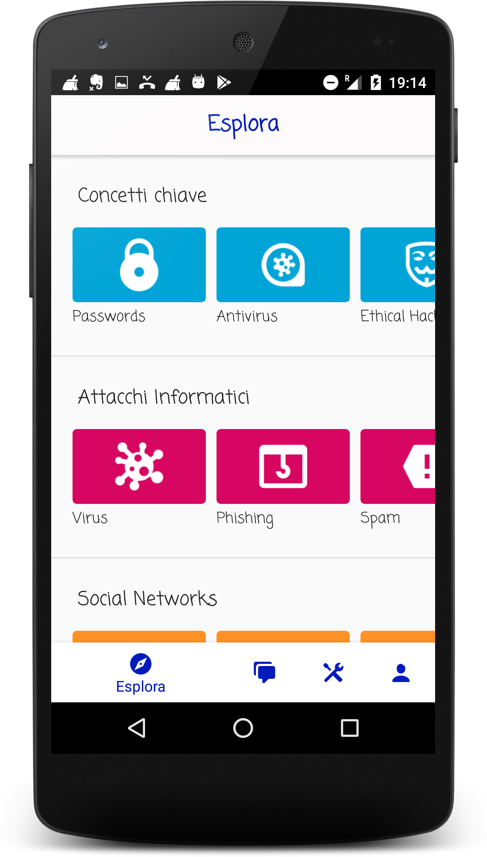
Explore many courses on cybersecurity

Slide 2
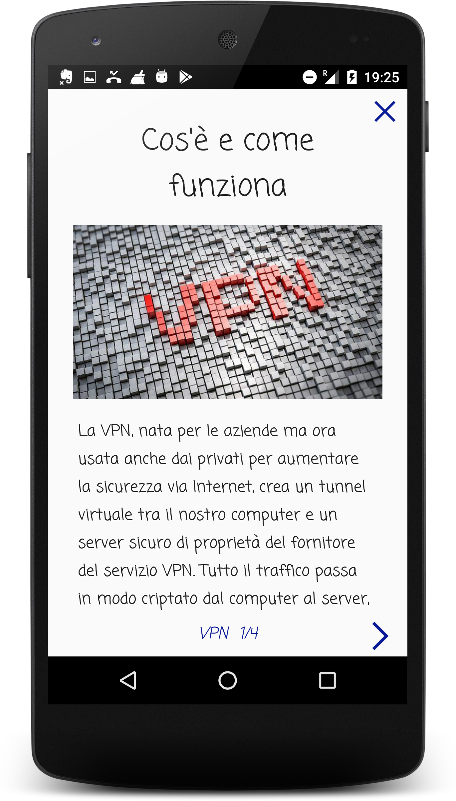
Learn with interactive lessons and quizzes

Slide 3
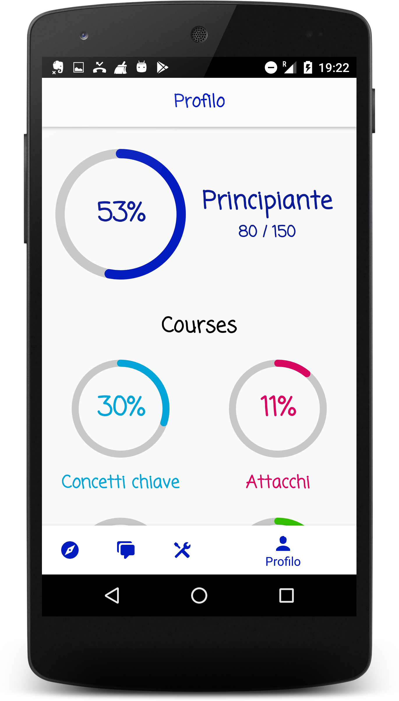
Track your progress and rise in the security ranks

Slide 4
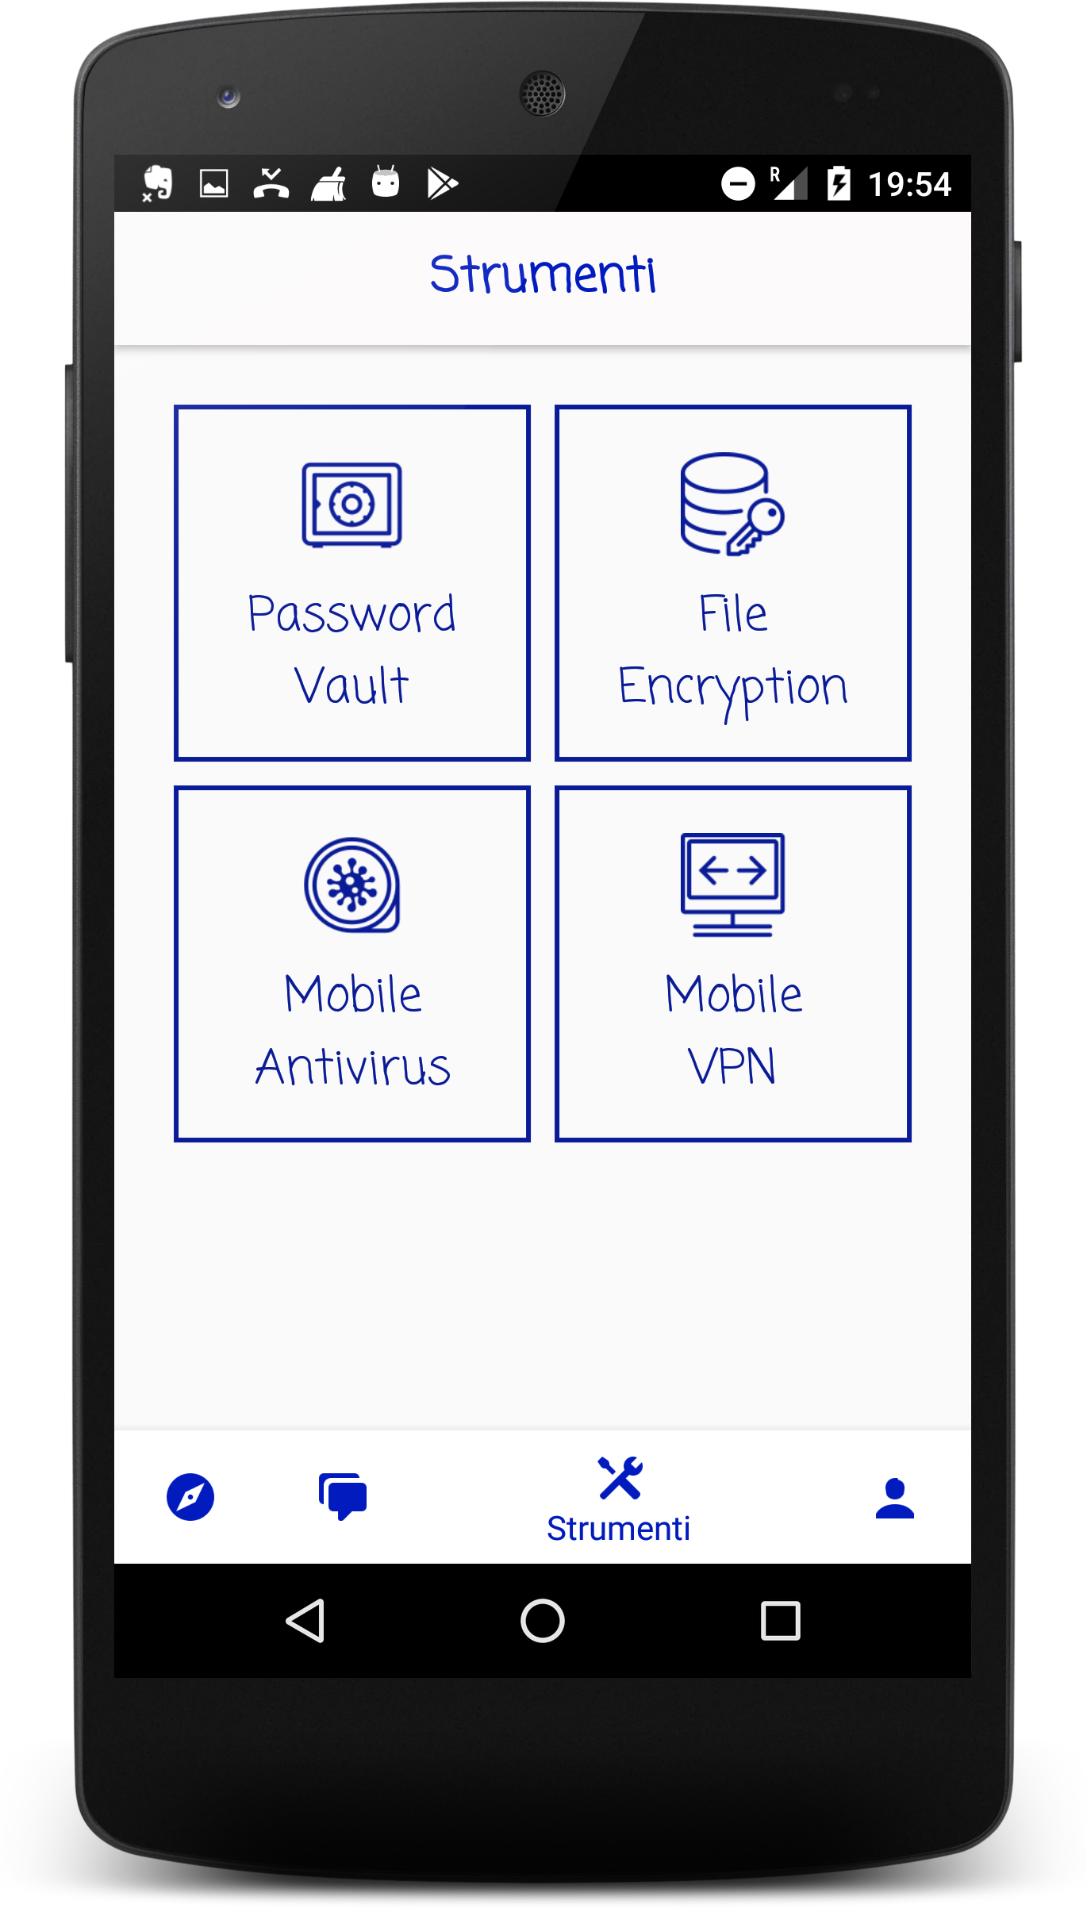
Access handy tools for your privacy

Slide 5
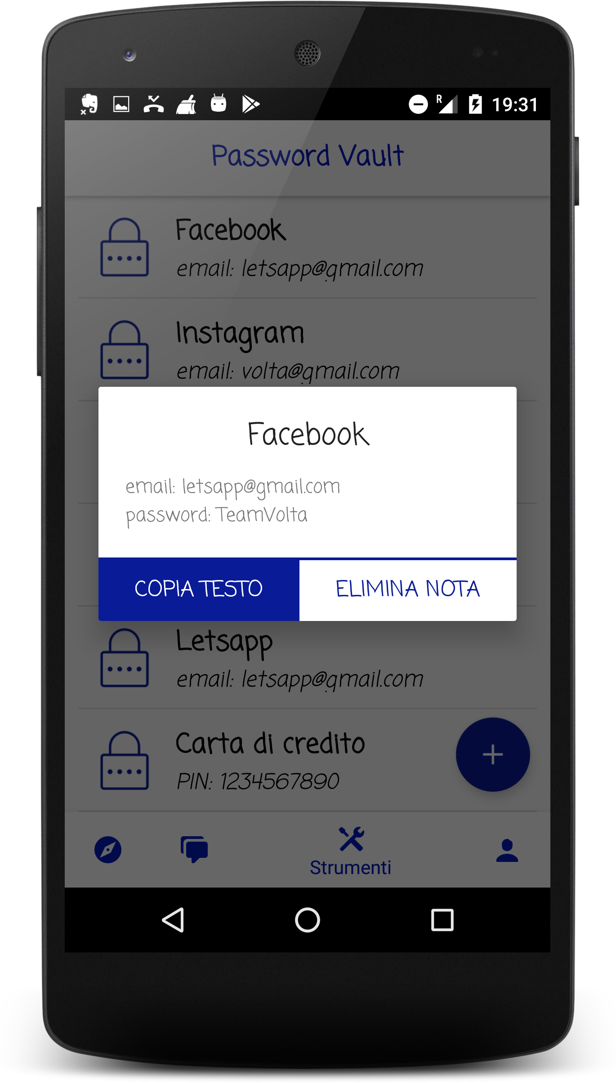
Keep all your passwords safe in the password vault

